Slide 1
Netflix Titles Plot Popularity Detailed Analysis
Jorge García Navarro

Slide 2
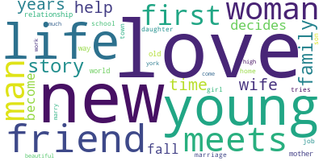
Index
Project Objective
Development
Project Steps
Streamlit
Conclusions

Slide 3
Project Objective

Slide 4


Project Objective
The chosen topic was to analyze Netflix Titles Plots aiming to find the most popular words from each genre.
Three different datasets were used containing information from both Netflix and IMDb.
This creates a path to a future Machine Learning project.

Slide 5
Hypothesis:
The genre Drama has the highest mean rating and its most popular words are: murder and vengeance.
Plot Twist: Not True

Slide 6
2. Development
2.1 Project Steps
2.2 Streamlit

Slide 7
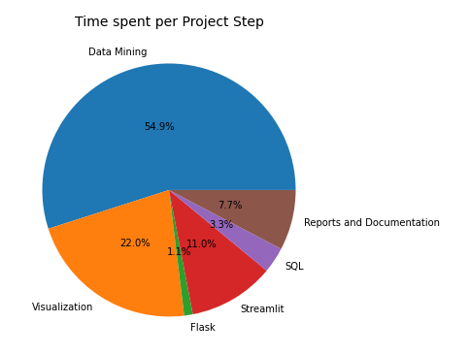
2.1 Project Steps

Slide 8
2.2 Streamlit
The presentation will continue in the Streamlit Dashboard.

Slide 9
3.Conclusions
Answering some EDA Questions

Slide 10
3. Conclusions Part I
a. Was it possible to demonstrate the hypothesis? Why?
After many data transformations on the Base Dataset, it was possible to find an answer to the stated hypothesis. The analyzed data showed not only that the best rated genre was Film-Noir instead of Drama, but neither 'murder' nor 'vengeance' were in the top 20.
b. What can you conclude about your data study?
Based on the analyzed data it can be stated that the genre 'Film-Noir' has the highest rating and the most common words by %_occurrence are: 'new', 'young', 'life'.

Slide 11
3. Conclusions Part II
c. What would you change if you need to do another EDA project?
The data mining should be more specific. There was not a clear goal at the beginning and valuable time was wasted on this particular task. Furthermore, the results would be more reliable if more data was gathered.
d. What did you learn doing this project?
To specify as much as possible the objective of the project and what is needed to reach that purpose.

Slide 12
Thank you for your attention
Linkedin : https://www.linkedin.com/in/jorge-garc%C3%ADa-navarro-532674108

